Slide 1

Inclusion Works: Strategies for Establishing States as Model Employers of People with Disabilities
October 27, 2022
3:00 pm – 4:30 pm ET
The State Exchange on Employment & Disability

Slide 2


Welcome!
Elise Gurney
Project Manager
The Council of State Governments
Center of Innovation

Slide 3

Housekeeping
Chat Box, Q&A box
Cameras and Microphones
Webinar Recording
Presentation Materials
Live Transcript

Slide 4
Today’s Webinar Agenda
3:10 – 3:15 Introductory Remarks from ODEP
3:15 – 3:25 Report Key Findings - “The State as a Model Employer of People with Disabilities: Policies and Practices for State Leaders”
3:25 – 4:15 Speaker Presentations
- Representative Naquetta Ricks (CO)
- Representative Catherine Abercrombie (CT)
- Representative Camille Lilly (IL)
- Executive Director Elizabeth Gordon (WA)
4:15 – 4:30 Moderated Q&A

Slide 5

Welcome!
Nadia Mossburg
Senior Policy Advisor
U.S. Department of Labor
Office of Disability Employment Policy

Slide 6



Introducing SEED
Initiative funded by the U.S. Department of Labor’s Office of Disability Employment Policy
Goal: Foster a nationwide workforce more inclusive of people with disabilities
Readies organizations that represent state and local policymakers to respond to disability employment and workforce development requests and inquiries

Slide 7
SEED as a Resource
Disability employment policy and subject-matter expertise
Targeted policy analysis and assistance to state and local policymakers (research, state gap analyses, draft legislation)
Tools and resources designed to assist state policymakers in crafting and sponsoring effective policies
Sample policy options that states can customize and advance within their own legislatures
Access to meaningful data on disability employment and related issues
Connections to federal agencies, as well as national community, advocacy and business organizations
DOL.gov/agencies/odep/state-policy

Slide 8
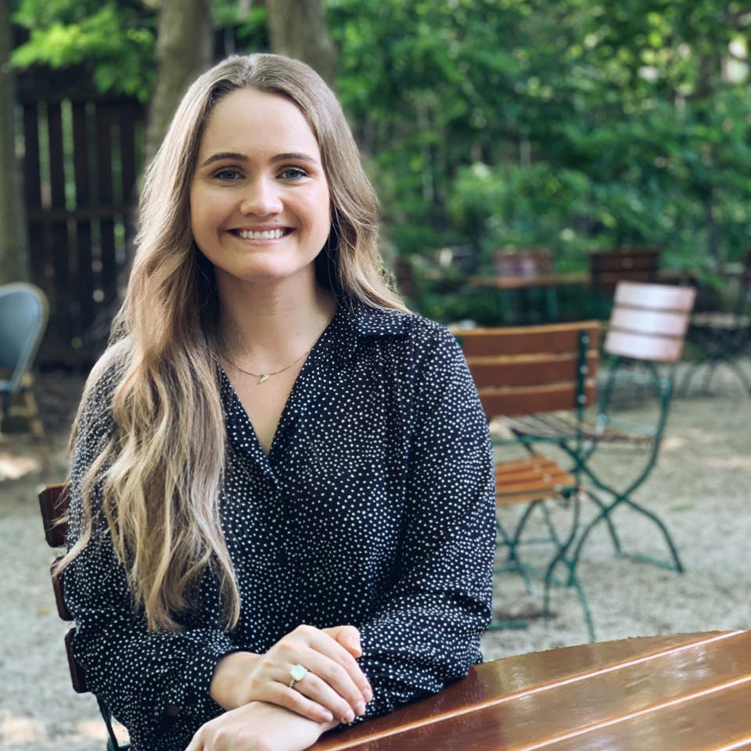
Report Contributor
Rachel Wright
Policy Analyst
The Council of State Governments
Center of Innovation

Slide 9

Key Findings: The State as a Model Employer of People with Disabilities – Policies and Practices for State Leaders
The State as a Model Employer of People with Disabilities: Policies and Practices for State Leaders offers public officials policy options as well as real-life examples of innovative policies and programs that states have successfully implemented to build a stronger, more inclusive public-sector workforce.

Slide 10

What are State as a Model Employer Policies?
SAME policies are adopted at the state level and apply to all public sector employers and employees. These policies are intended to advance the recruitment, hiring, advancement and retention of people with disabilities.

Slide 11
Benefits of Adopting State as a Model Employer Policies
The State as an Employer
Promote greater diversity, equity and inclusion in the public-sector workforce
Improve employee retention through cultivating sense of belonging
Spur innovation by giving agency to diverse voices and viewpoints
Respond to the “silver tsunami”

Slide 12
Benefits of Adopting State as a Model Employer Policies
Workers and Job Seekers with Disabilities
Improve employment outcomes
Increase economic self-sufficiency
Enhance quality of life
Facilitate community engagement

Slide 13
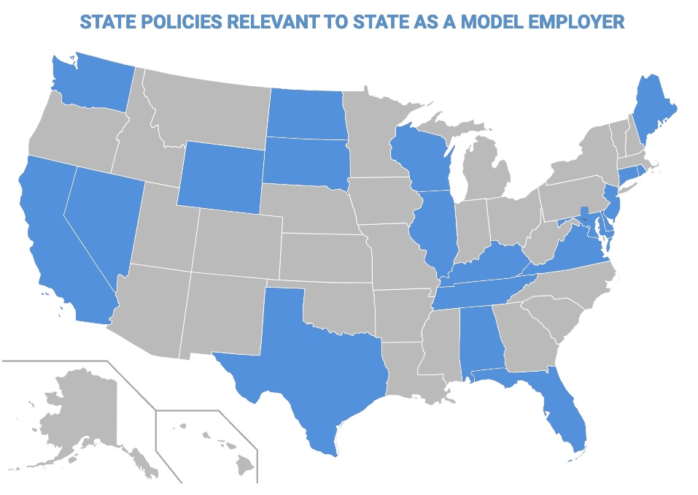
SAME Policies Are Gaining Traction
Currently, 20 states and the District of Columbia have adopted SAME policies statewide.
As evidenced by 2022 legislative sessions, SAME policies are gaining traction in the states - by February, over 100 SAME bills were introduced throughout all 50 states.

Slide 14
State as a Model Employer Policy Options
1
Adopting formal mechanisms (e.g., legislation executive orders)
4
Developing comprehensive, government-wide strategic plans
2
Creating infrastructures (e.g., cabinet positions, task forces, working groups, advisory committees)
5
Instituting fast-track and other hiring systems to facilitate employment
3
Extending diversity and inclusion initiatives
6
Enacting advancement and
retention practices

Slide 15
State as a Model Employer Policy Options, Cont.
7
Ensuring accessibility of information and communication technology
8
Ensuring availability of personal
assistance services
9
Developing disability awareness training for state personnel

Slide 16
State Spotlight – Ohio Vocational Apprentice Program
Policy Option: Creating Infrastructures
Opportunities for Ohioans with Disabilities oversees the Vocational Apprentice Program, which places vocational rehabilitation clients in paid internships with state agencies.
The goal of the program is for apprentices to secure permanent employment in state government upon completion of their apprenticeship.
Apprentices Gain:
Work Experience
Networking Opportunities
Access to Public Sector Employment

Slide 17
State Spotlight – Alaska Governor’s Council on Disabilities and Special Education Workforce Survey
Policy Option: Extending Diversity and Inclusion Initiatives – Implementing Annual Reporting Mechanisms and Surveys
The Alaska Governor’s Council on Disabilities and Special Education surveyed state workers to monitor the representation of employees with disabilities in Alaska state government and solicit recommendations for improvement.
Survey Outcomes
Provisional Hire Program (2014)
Disability-inclusive telework policies
State as a Model Employer Task Force (formed in 2021)

Slide 18
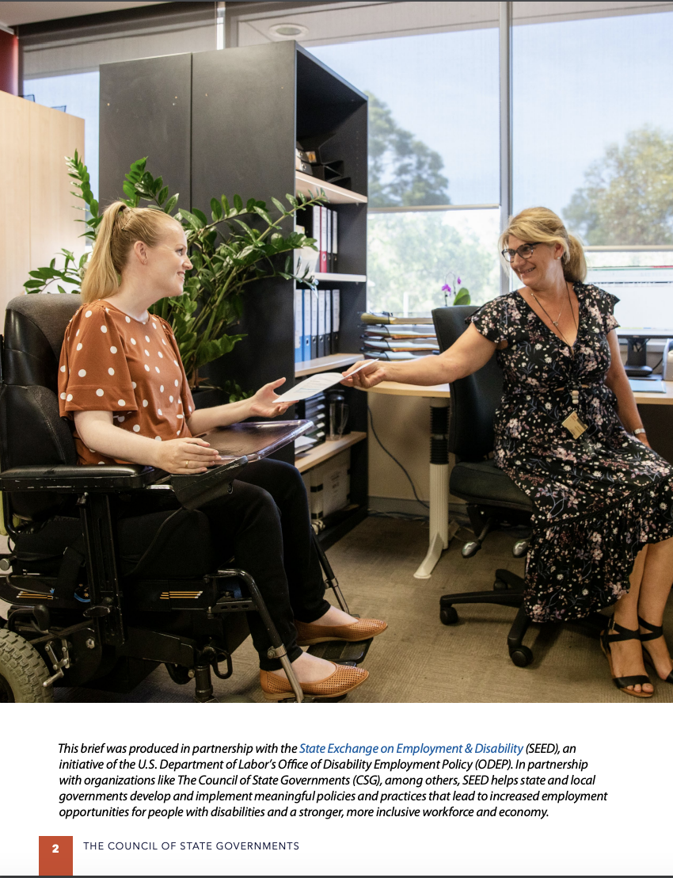
Thank you!
https://seed.csg.org/wp-content/uploads/2022/07/Accessible-Final_SAME_SEED_Report.pdf

Slide 19
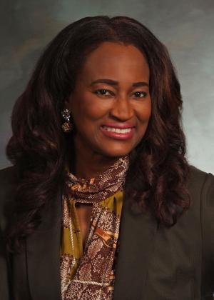
Representative Naquetta Ricks
Representative Naquetta Ricks
Colorado General Assembly

Slide 20

State as a Model Employer Policies & Practices: Colorado
Rep. Naquetta Ricks
Colorado HD-40

Slide 21
Colorado’s
SAME History
The Office of the Lt. Governor hired a full-time Disability Policy Advisor
General Assembly passed Senate Bill 16-077
The Governor’s Office published the 2018 Community Living Report
The Governor issued Executive Order 2020 175 to address Equity, Diversity and Inclusion
CDLE launched the Disability Hiring Preference Pilot, created by SB21-095
2016
2018
2020
2022
2017
2019
2021
EFAP submitted a recommendation to the GA for the State to become a Model Employer
CDLE hired a full-time State Advisor on Disability Employment
The Office of the Lt. Governor expanded their disability focus by adding to the team
The Governor’s Office hired a temporary Disability Policy Advisor focused on Olmstead compliance
Notes:
2016: The Employment First Advisory Partnership (EFAP) was directed to develop a strategic plan to expand competitive integrated employment (CIE) outcomes for people with disabilities through Employment First policies and practices
2018: Colorado’s Community Living Plan was first created in 2014, with its first report published in 2018: the plan calls for community-based services, supports, and housing for individuals with disabilities who live in long-term care facilities and wish to return to the community, or who wish to remain in their own homes.
2020: Governor Polis directed the Department of Personnel and Administration to lead state action on equity, diversity and inclusion for the state through Executive Order 2020-175. The order also directed state agencies to create long-term strategic plans with the goal of inclusive, anti-discriminatory workplace cultures and implementing equitable hiring, compensation and retention practices.
2022: On March 1, the Colorado Department of Labor and Employment (CDLE) launched the Disability Hiring Preference Pilot created by SB21-095. The pilot will run through December 2027.

Slide 22
Disability Hiring Preference Pilot
SB21-095 Sunset Employment First Advisory Partnership Extension: CDLE Disability Hiring Preference Pilot
Similar to Veterans’ Preference
Individual will choose to disclose, and submit verification documentation of disability
In a numerical scoring method, automatic 5 points applied; non-numerical is automatically moved to next round
Increases chances of being considered for a position
Requires minimum qualifications are met
Notes:
The Employment First Advisory Partnership (EFAP) is an active, involved advisory
group created by SB16-077 to comport with changes in federal policies and
guidelines regarding the employment for individuals with disabilities.
● Employment First is a nationally recognized term that prioritizes employment as the
first and preferred outcome for all working age persons with disabilities, regardless
of the level of disability.
● Since the creation of EFAP, the group has made great strides and continues to focus
on policies, programs, and practices that increase integrated employment of
individuals with disabilities. However, Colorado has yet to realize measurable
expansion of employment outcomes for individuals with disabilities. Extending EFAP
will ensure Colorado continues to develop and implement policies and practices that
will allow for the full participation in the workforce by all those interested in
pursuing competitive integrated employment.
● To support a recommendation of EFAP and the implementation of policies and
practices aligned with “State as Model Employer,” amendment L.001 passed in the
Senate that creates a hiring preference pilot at CDLE for the hiring of individuals
with disabilities, similar to the veterans preference currently offered at the state.
● Creating a disability hiring preference pilot within state government will enable the
State of Colorado to model inclusive hiring practices, access to the best talent, and
ensure individuals with disabilities are afforded the opportunity to compete for and
obtain employment aligned with their unique talents within state agencies.

Slide 23
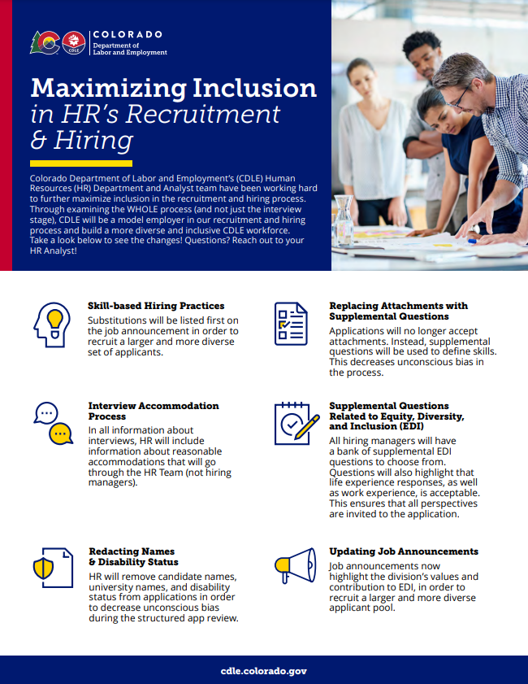
Changes to the Hiring
Process:
Incorporating Skill-based Hiring Practices
Replacing Attachments with Supplemental Questions
Updating the Interview Accommodation Process
Providing Supplemental Questions Related to Equity, Diversity, and Inclusion (EDI)
Redacting Names and Disability Status
Updating Job Announcements
Notes:
Skill Based Hiring Practices
Recruit a larger and more diverse set of candidates
Get a fuller picture of their experiences
Replacing Attachments with supplemental questions
Decreased unconscious bias
Help you think through the necessary position and skills for the job
There employer spends less time sifting through different attachments
Updating the Interview Accommodation Process
Applicants will be more likely to disclose = more applicants
Clearer sense of applicants’ skills
Fewer things for you to remember
Providing Supplemental Questions Related to EDI
Bank of supplemental questions related to EDI will be available to choose from so that hiring managers can intentionally build the culture you want
Redacting Names and Disability Status
Decreased unconscious bias for you to worry about
Removes “prestigious university = perfection” bias
Updating Job Announcements
All applications will have a job announcement video to highlight the division’s values and contribution to EDI >> more diverse pool of candidates

Slide 24
Accessibility
Accessibility Standards from the Department of Personnel and Administration (DPA)
  Key Areas: Physical Space, Systems, Communications
  Stakeholder Interviews
  State Research
DPA State Agency ADA Coordinator’s Workgroup
  Network
  Quarterly Meetings
Capitol Complex Accessibility Study
  Identify Issues to Prioritize Funding
CDLE Accessibility Task Force

Slide 25
Statewide Trainings
EDI Training for all State Staff
  Disability is Included with Broader EDI Training
EDI Training for Supervisors and Managers
  Includes Reasonable Accommodations Requirements & Process
Global Accessibility Awareness Day
  Promoted Digital Accessibility to State Staff
  Webinar By and For State Employees
Disability Etiquette Trainings (CSEAP: Colorado State Employee Assistance Program)
State Agency ADA Coordinator Trainings

Slide 26
Culture
Employee Resource Groups (ERG)/Affinity Spaces
Raising Awareness through Trainings
Lunch-N-Learns focused on Disability Topics
National Disability Employment Awareness Month (NDEAM)
Self-Identification Campaigns & Opportunities
Colorado For All Video
Notes:
Employee Resource Groups
Disability Affinity Group @ CDLE
Division of Vocational Rehabilitation (DVR) EDI Task Force
Colorado For All video
Promoting diversity as a component of an inclusive workforce, including disabilities - hidden, visible, behavioral health
National Disability Employment Awareness Month
Events, Press Releases, Lunch-N-Learns, Social Media, etc.

Slide 27
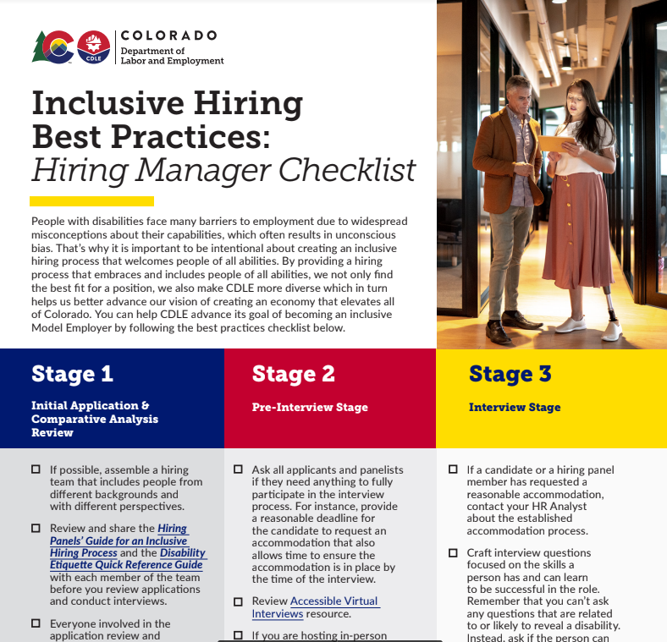


What’s the Latest in Colorado?
Raising Awareness
  Training for hiring managers, hiring panels, supervisors, managers, and all employees
Fostering Inclusion
  Equity, Diversity, & Inclusion (EDI) Efforts
  Employee Resource Groups/Affinity Groups

Slide 28
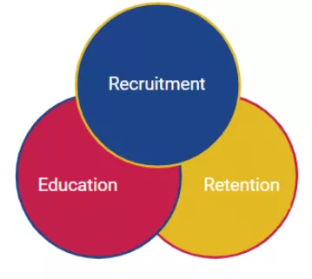
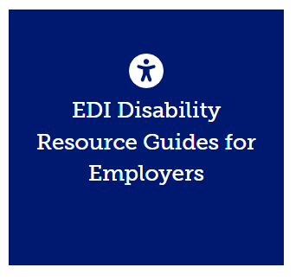
What’s the Latest in Colorado?
Increasing Collaboration
  Business Relations Unit (BRU) within Division of Vocational Rehabilitation (DVR)
  State ADA Coordinator Resource Group
  Lt. Governor Quarterly Round Table

Slide 29
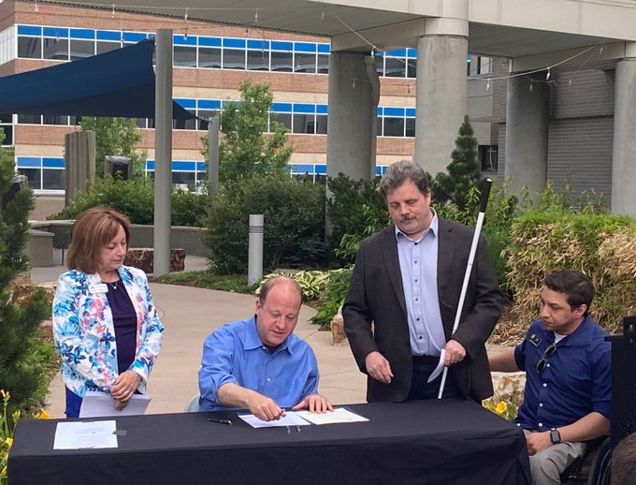

What’s on the
Horizon?
House Bill 21-1110 Implementation
Equity Office Implementation
Centralized Accommodation Fund
Implementation
Statewide ADA Coordinator Hiring
Skills-Based Hiring Implementation
Notes:
H21-1110: In 2021, Colorado enacted House Bill 1110, requiring the Chief Information Officer in the Office of Information Technology to, “promote and monitor the access standards for individuals with a disability in the state’s information technology infrastructure, including but not limited to architecture.” Each state agency is directed to comply with the access standards for people with a disability.

Slide 30

Hopes for the Future
Expansion of the
Disability Hiring
Preference Pilot
Statewide Disability
Plan
Self-Identification Opportunities & Campaign

Slide 31
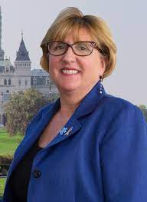
Representative Catherine Abercrombie
Representative Catherine Abercrombie
Connecticut House of
Representatives

Slide 32
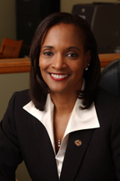
Representative Camille Lilly
Representative Camille Lilly
Illinois General Assembly

Slide 33
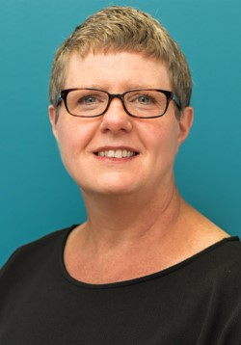
Executive Director Elizabeth Gordon
Elizabeth Gordon
Executive Director of the Governor’s Committee on Disability Issues and Employment, State of Washington

Slide 34
Audience Questions?
Please send any questions you have for our presenters to our moderator via the “question and answer” function on Zoom. This is located in the tool bar at the bottom of your screen.

Slide 35
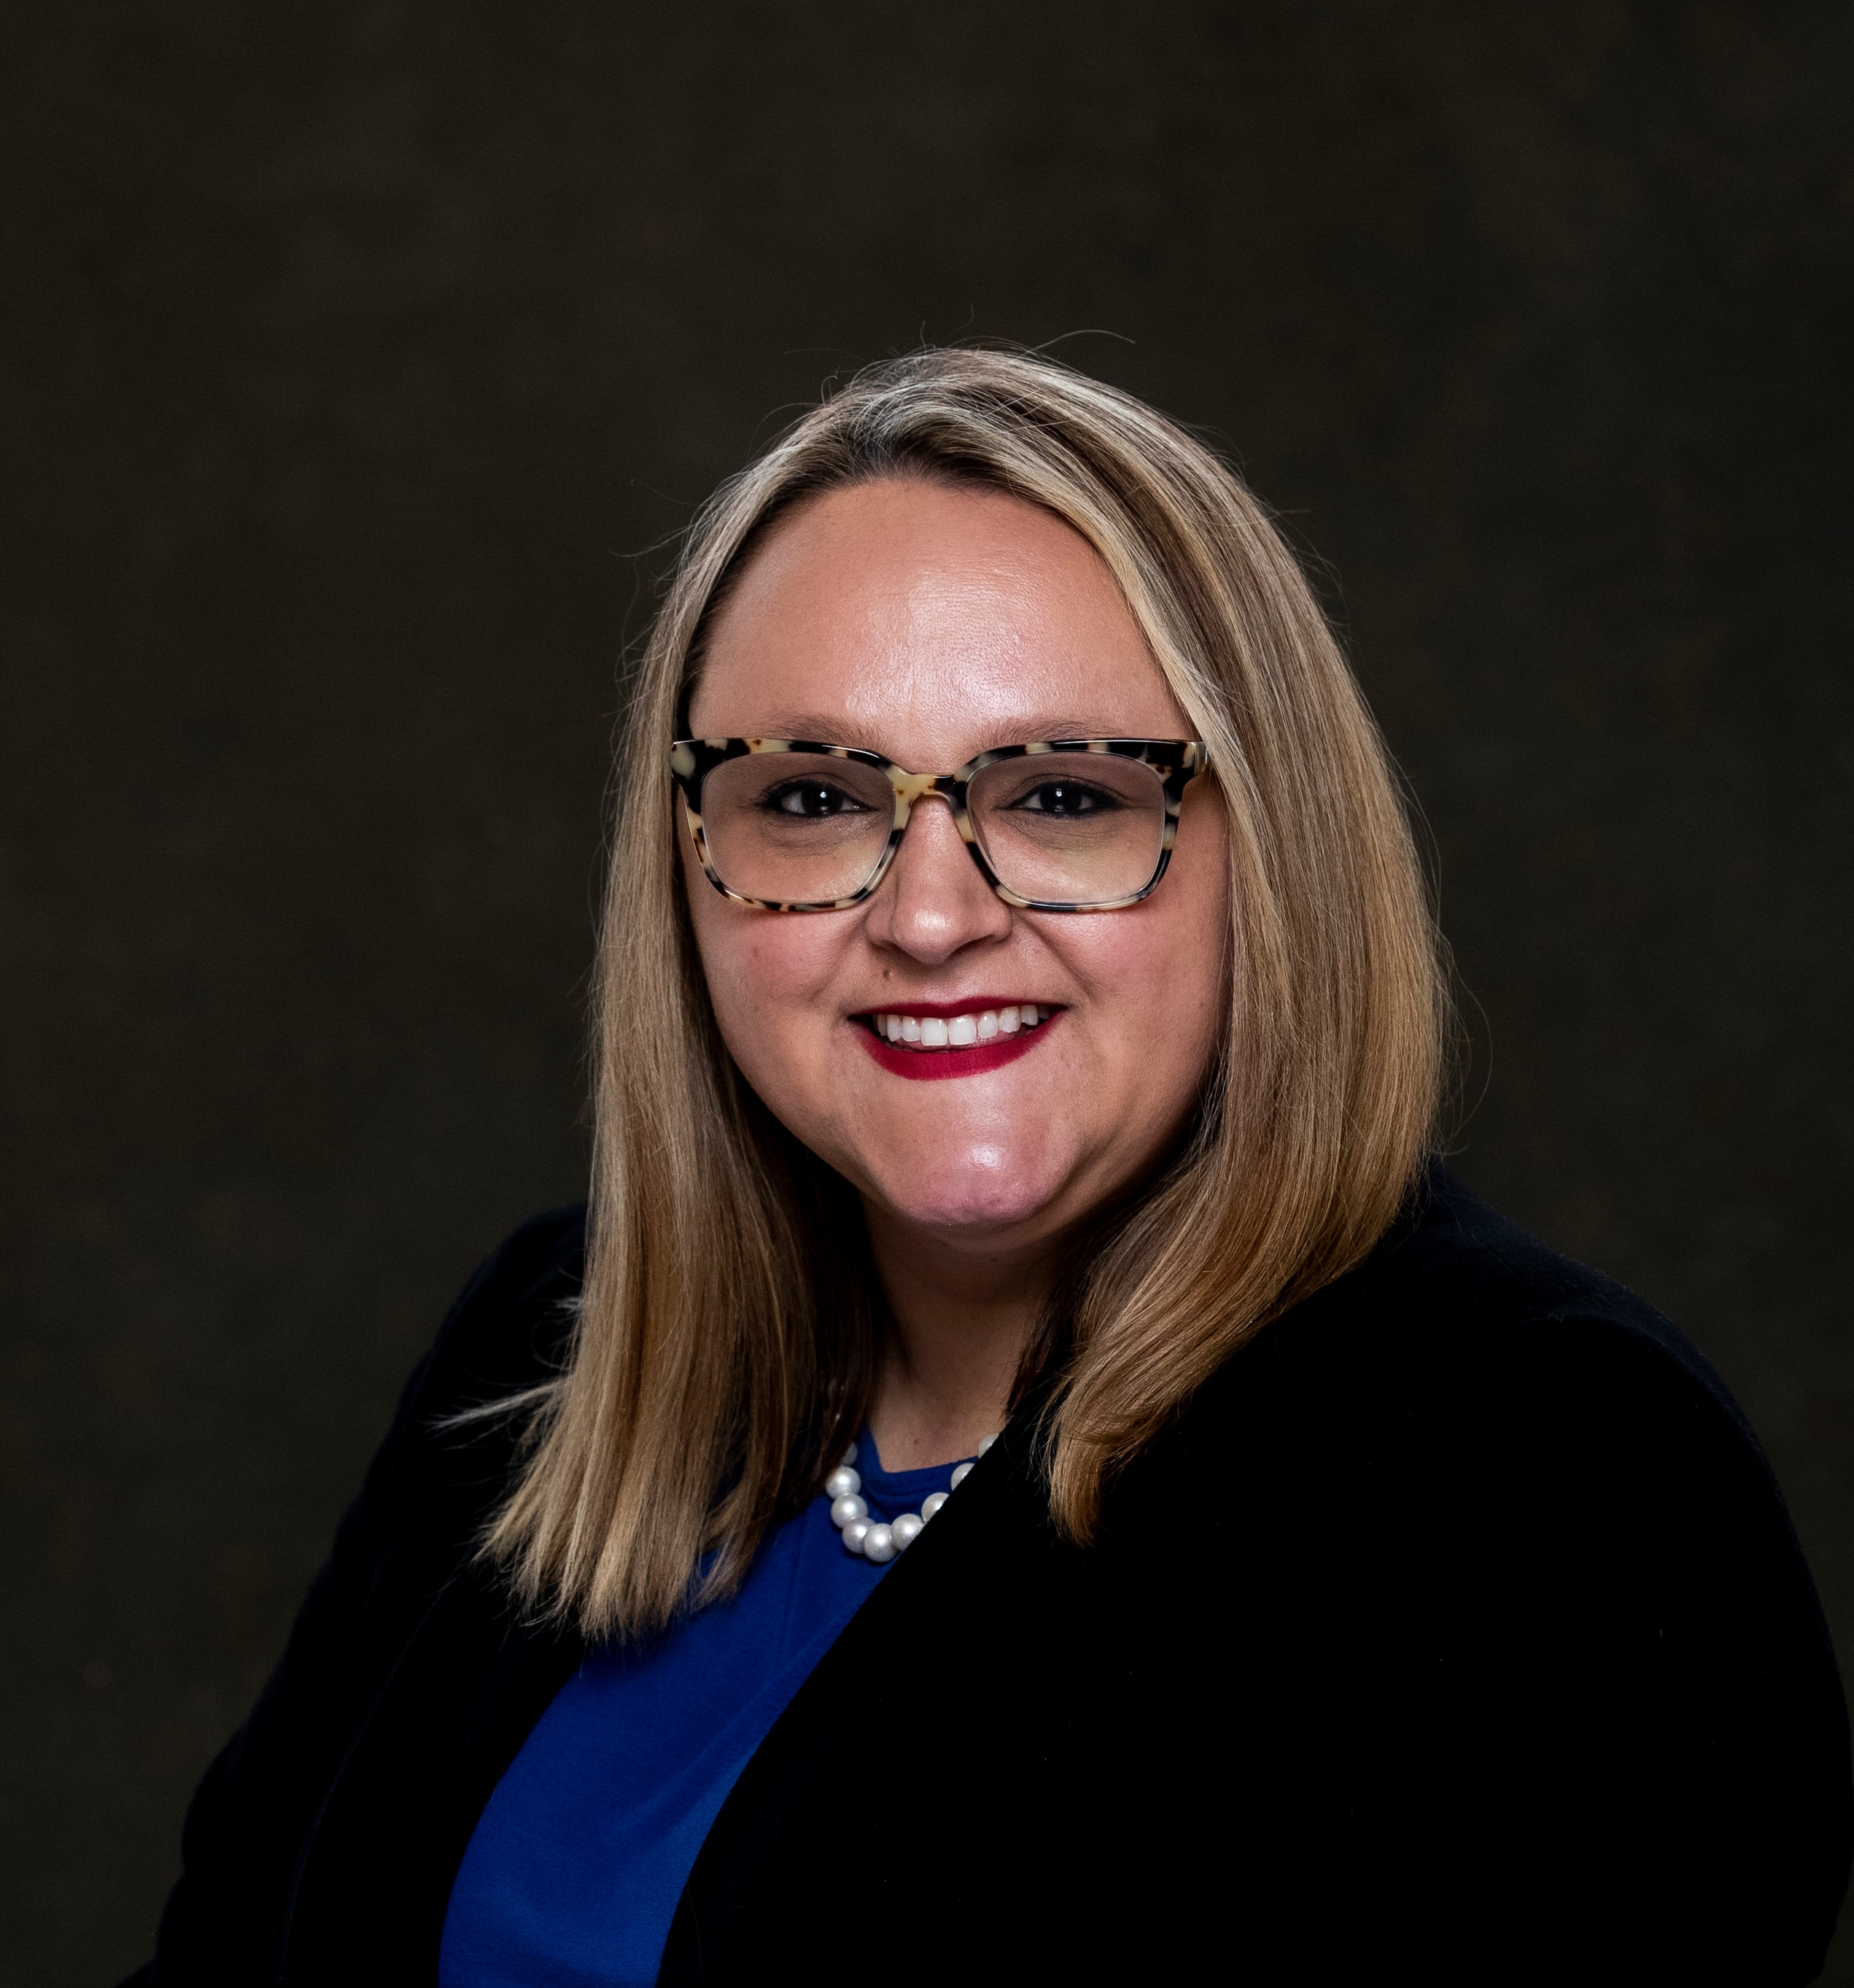
Questions?
Dina Klimkina
Program Director​
dklimkina@csg.org​
Elise Gurney
Project Manager
egurney@csg.org
Rachel Wright
Policy Analyst
rachel.wright@csg.org

Slide 36
Thank you for attending!

